Slide 1



RAJIV GANDHI UNIVERSITY OF KNOWLEDGE AND TECHNOLOGIES
LIBRARY MANAGEMENT SYSTEM FOR OUR IIIT SRIKAKULAM
GUIDE NAME:
Mr. N. SESHA KUMAR SIR
ASSISTANT PROFESSOR
S.PAVAN KUMAR (S180614)
G.HARITHA(S180510)
CH.RAMADEVI(S180253)

Slide 2

CONTENT:
Introduction
Problem Statement
Abstract
Scope of the Project
Differences between existed and proposed system
Disadvantages of Existed System
Proposed System Features
Advantages of Proposed System
Technologies used
Hardware and Software requirements
Future Enhancement
Conclusion

Slide 3

INTRODUCTION:
A library management system is a type of software that facilitates the management of collections in educational and public libraries as well as the streamlining of processes and improvement of user experience.
Explanation of the importance of LMS: "Manual library management can be time-consuming and ineffective, resulting in mistakes and lower productivity. Many library operations, including cataloguing, circulation, improving their efficiency, accuracy, and scalability. As a result, librarians may concentrate on delivering excellent services to clients and developing their collections.

Slide 4

Problem Statement:
Librarians manage library resources and services by hand. It emphasizes the necessity of a modern library management system to streamline operations and automate tasks. Features including book acquisition, borrower data management, and report generating should be included of the system. It should have an easy-to-use user interface so that librarians may complete tasks quickly. To safeguard library resources and guarantee authorized access, security measures are crucial. The system should be scalable and flexible enough to accommodate the particular needs of various libraries. The usage of a library management system can improve user experience, increase productivity, and save time and money.

Slide 5
Abstract:
The functions and resources of a library are managed by the library management system, a piece of software. This technology automates a variety of library functions, such as circulation, procurement, and stock maintenance. The librarian may effortlessly complete a variety of tasks, including adding, modifying, and deleting books, searching for books, maintaining borrower information, and generating reports, thanks to the library management system's effective and user-friendly interface. The system is designed to provide library staff and users with prompt and accurate information while ensuring efficient and effective management of the library's resources. The system uses a single database to keep track of all information about books, borrowers, and library transactions in order to maintain data accuracy and consistency. Additionally, the library management system offers security capabilities to guarantee the protection of the library's resources and prevent unauthorized access. With the aid of this system, librarians can efficiently run the library and give customers a better experience.

Slide 6

SCOPE OF THE PROJECT:
A library management system automates and streamlines library operations. It covers functionalities like book acquisition, borrower information management, reservation and holds, reporting and analytics, and security measures. The system aims to improve efficiency, enhance user experience, and safeguard library resources. It should be scalable, adaptable, and capable of integration with other systems or services.

Slide 7
DIFFERENCES BETWEEN EXISTED AND PROPOSED SYSTEM:
FEATURES:
EXISTED SYSTEM:
PROPOSED SYSTEM:
Technology Stack:
Scalability:
User Interface:
Data Management:
Customizability:
Existing library management systems depend on Relational Database Management Systems such as MySQL, Oracle, and others.
In comparison to the proposed system, the current system is not more scalable.
It is made with outdated front-end technologies, making it less dynamic and responsive.
It uses an RDBMS, which limits performance and flexibility when managing huge amounts of data.
Customizing and expanding it further might not be much simpler.
MERN stack could make use of a more modern technological stack.
MERN stack is known for its scalability, which means it may be better able to handle large amounts of traffic and data.
It may have a more responsive, perceptive, and engaged user because it is developed with the MERN stack.
It makes use of Mongo DB, a No SQL database with greater performance and flexibility for managing massive amounts of data.
It might be simpler to modify and add to it.

Slide 8
Disadvantages of Existed System:
Inefficient workflow: Manual systems lead to inefficiencies and errors in managing library operations.
Limited accessibility: Users face limitations in accessing information and resources.
Time-consuming tasks: Manual systems require more time and effort for routine tasks.
Lack of real-time information: Manual systems lack real-time access to book availability and user requests.
Data inaccuracy and loss: Manual systems are prone to human errors and the risk of losing or damaging physical records.
Limited reporting and analysis: Manual systems make generating reports and obtaining insights challenging.
Difficulties in collaboration: Manual systems hinder efficient collaboration and consistency.
Lack of security: Manual systems offer limited security measures.
Inefficient resource management: Manual systems make it difficult to track and manage resources effectively.

Slide 9
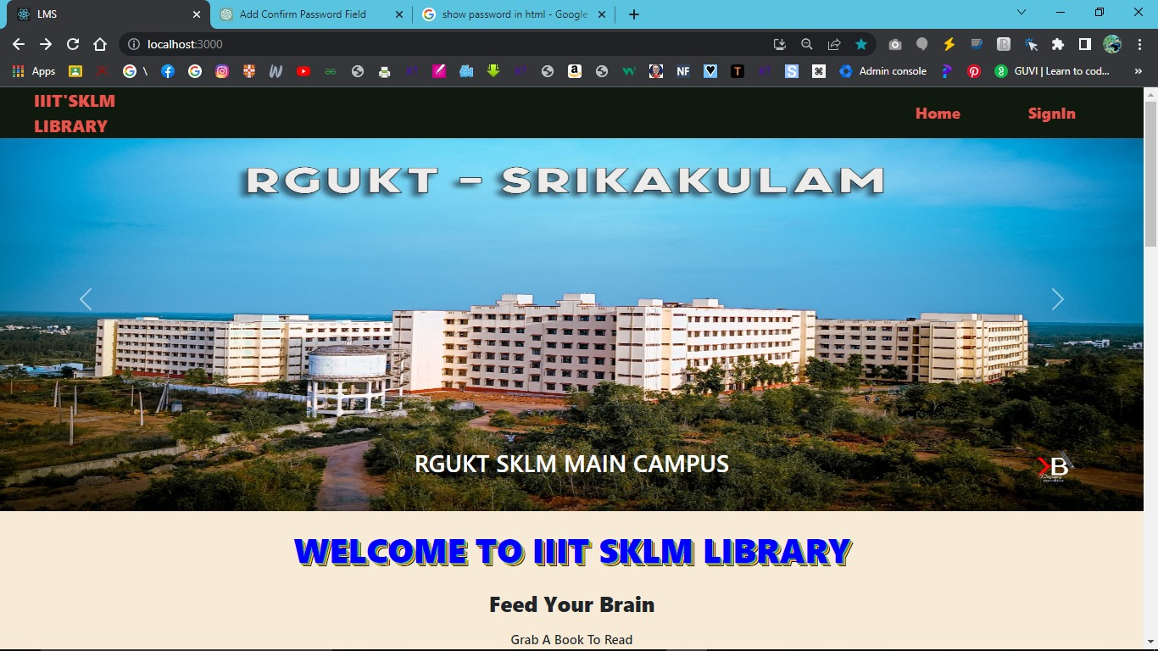
Proposed system FEATURES:

Slide 10
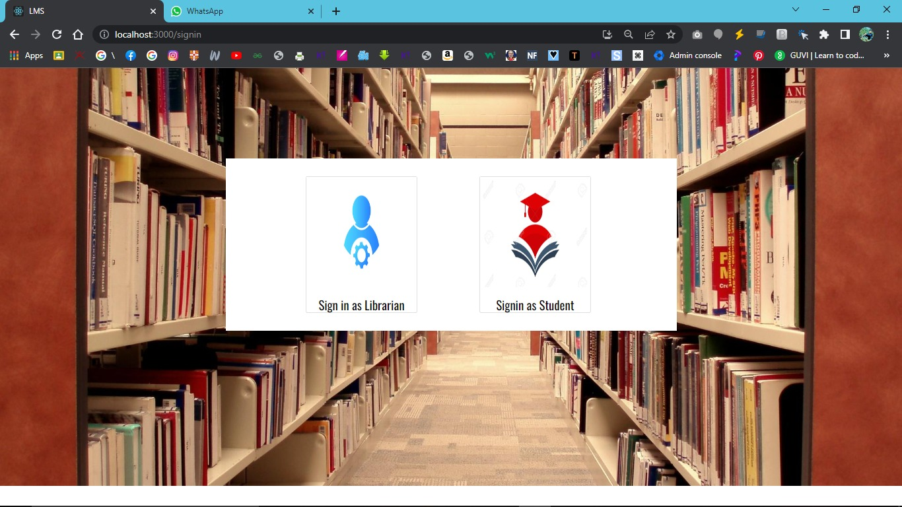
LOG IN PAGE:

Slide 11
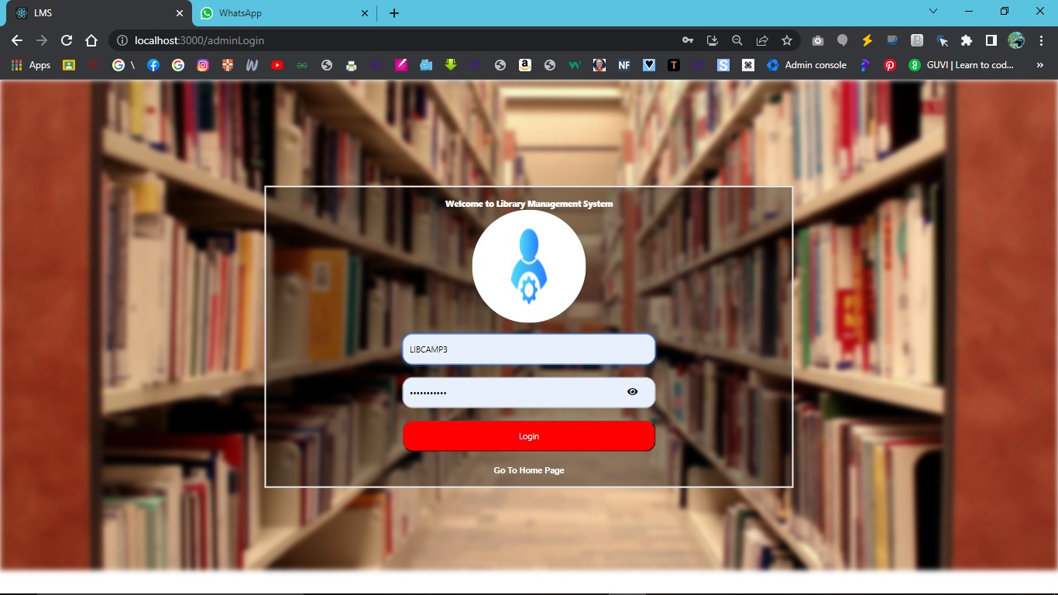
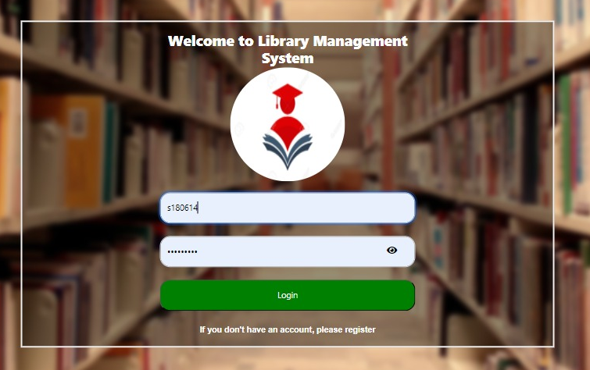
LIBRARIAN LOGIN AND STUDENT LOGIN PAGE:

Slide 12
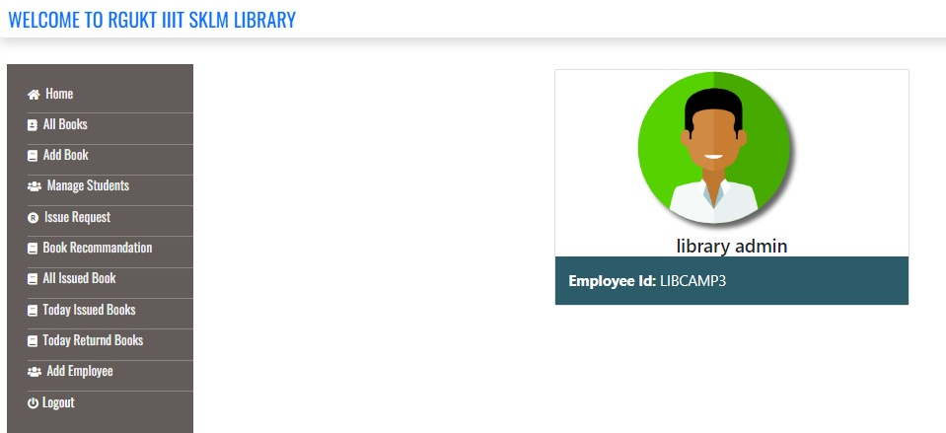
LIBRARIAN DASHBOARD and functionalities:
THE ABOVE ARE THE FUNCTIONALITIES OF THE LIBRARIAN TO AUTOMATE LIBRARY FUNCTIONS.

Slide 13
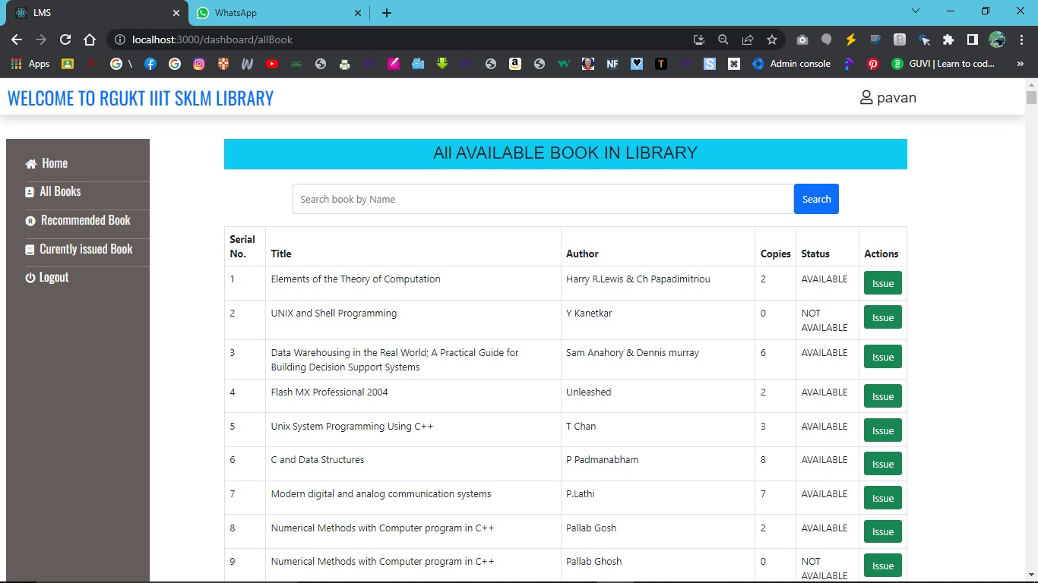
FUNCTIONALITIES OF STUDENT:
TO SEE ALL AVAILABLE BOOKS IN THE LIBRARY BY THE LIBRARIAN AND STUDENT DASHBOARD
(EASY TO SEE AND SEARCH THE BOOKS IN THE ALL BOOKS)

Slide 14
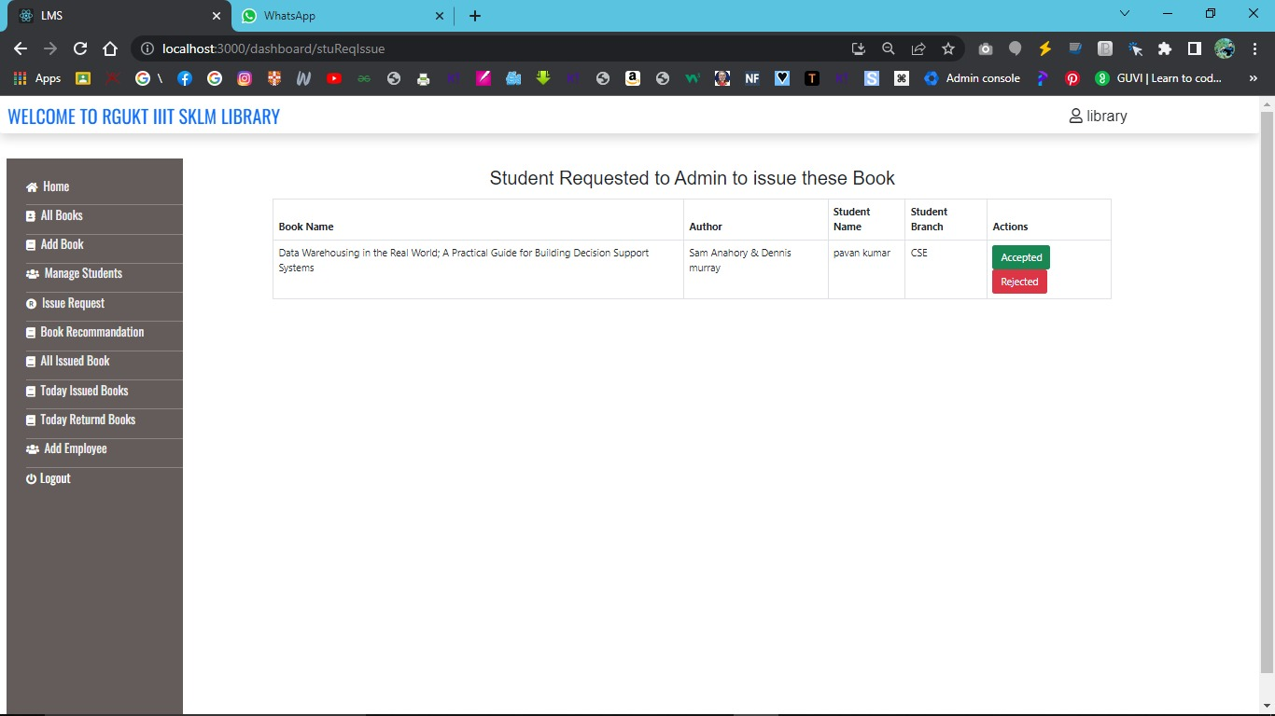
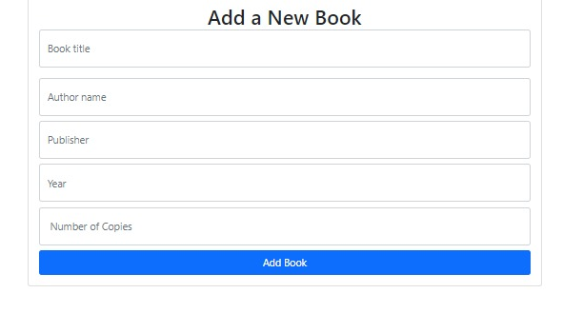
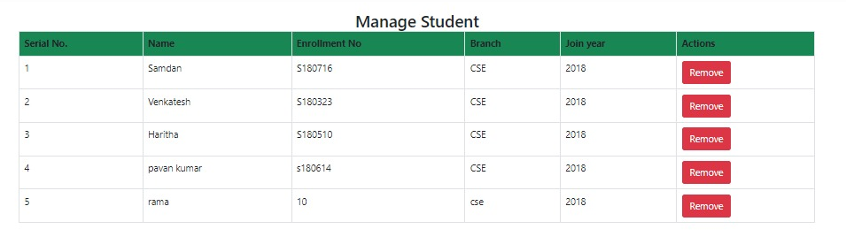
STUDENT REQUESTED TO LIBRARIAN TO ISSUE THE BOOKS
EASY TO ADD A NEW BOOK
EASY TO MANAGE STUDENTS BY THE LIBRARIAN BY MULTISELECT OPTION

Slide 15
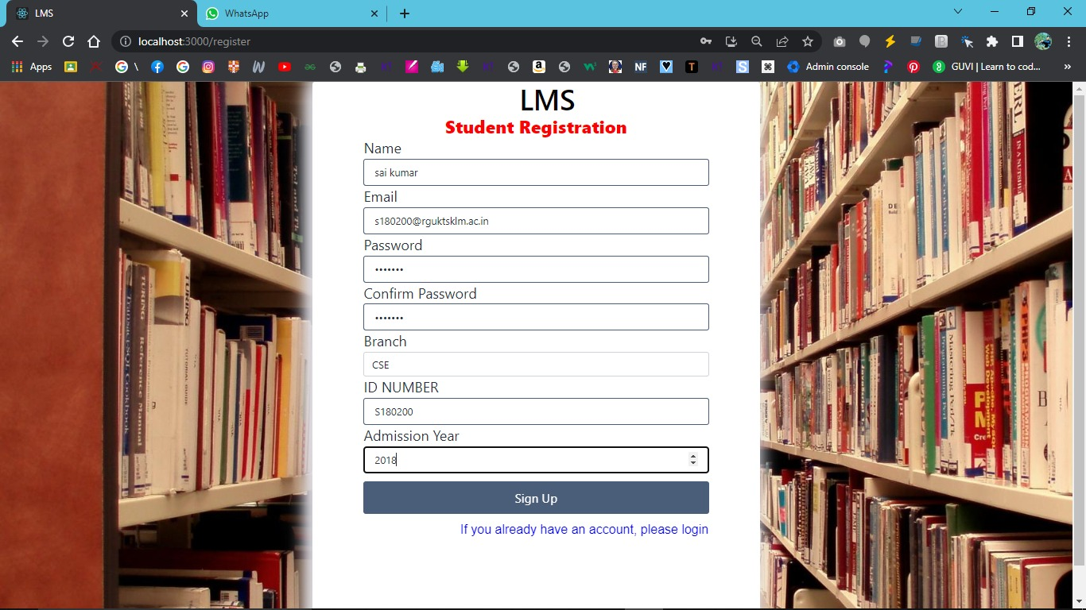
Authentication and Authorization:
GUIDELINES TO STUDENT REGISTRATION:
1.FOR THE EMAIL FIELD GIVE APPROPRIATE EMAIL.
2.ENTER SAME AS PASSWORD IN CONFIRM PASSWORD.
3.PASSWORD MUST BE IN ABOVE 7 CHARACTERS.
4.GIVE ONLY BRANCHES IN DROPDOWN MENU.
5.GIVE APPROPRIATE ADMISSION YEAR.
BY USING THE ABOVE GUIDELINES IT PREVENT UNAUTHORIZED ACCESS TO SENSITIVE DATA AND USER INFORMATION.

Slide 16
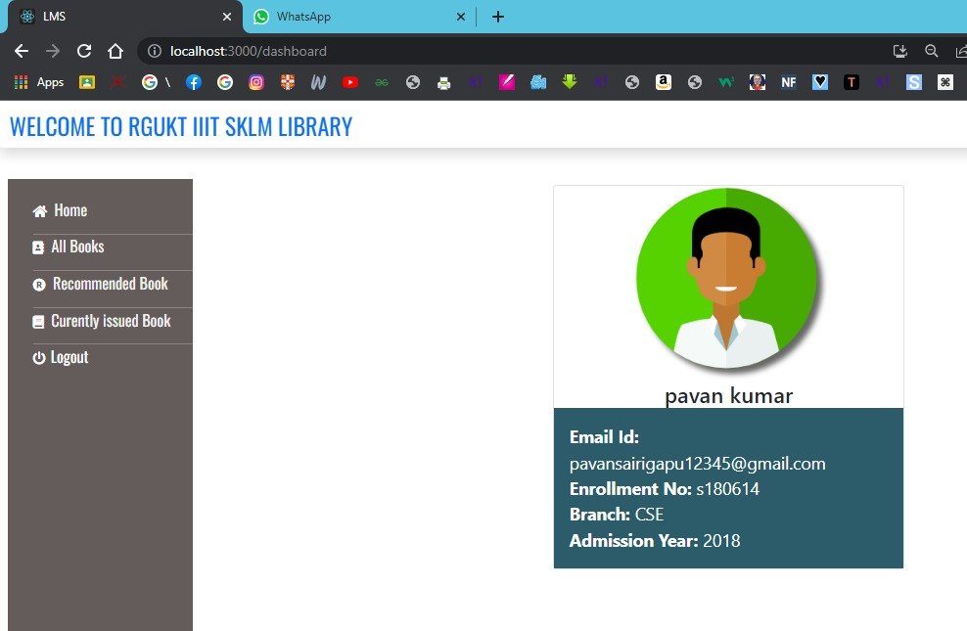
STUDENT DASHBOARD:
STUDENT FUNCTIONALITIES:
TO SEE ALL AVAILABLE BOOKS.
THEY USED TO RECOMMEND ANY BOOKS FOR THE LIBRARY.
THEY SEE THEIR CURRENTLY ISSUED BOOKS
THEY CAN EASILY SEE THEIR DETAILS RELATED TO THE LIBRARY.

Slide 17
ADVANTAGES OF PROPOSED SYSTEM:
Efficient Book Management: Ensuring that the interface for adding, editing, and deleting book records is user-friendly and includes information like the title, author, copies, and availability status.
Seamless Borrowing and Returning: Make it simple for users to quickly determine whether books are available, borrow them, and quickly return them. Develop an efficient workflow to manage book transactions.
User Management: For users, include user registration, login, and profile management features. Ensure customized user experiences and secure system access.
Advanced Search: Give users the option of searching for books by title, author, or other factors. It assist consumers in quickly finding the books they are looking for.
Performance and Scalability: Build the system to support many simultaneous users and optimize database queries for speed. Ensure responsiveness and efficiency even during periods of high usage.
Secure Authentication and Authorization: Implement a strong authentication mechanism to guarantee that only users who have been given permission can access the system. Prevent unauthorized access to sensitive data and user information.
User-Friendly Interface: To improve user experience and make the system simple to use and navigate, create a contemporary, intuitive, and responsive user interface using React.

Slide 18
TECHNOLOGIES USED:
MERN STACK ( MONGO DB , EXPRESS JS ,REACT JS, NODE JS)
MERN stack is an open-source full-stack JavaScript solution for quickly and easily developing and deploying full-stack applications. Therefore, each component of MERN serves a specific purpose that we must understand.
MONGO DB: A Platform-Independent
It is an open-source. It’s a No SQL database with JSON document-based schemas. Mongo DB is adaptable, and its document model defines objects in code, allowing for easy data manipulation and it has high availability.
EXPRESS JS: Framework for the back end
Express is a Node.js back-end web application framework. It has many features that make developing web applications easier. It aids in the creation of HTTP and URL-based application routes. Express includes several middleware components to help with additional tasks.

Slide 19
REACT JS : Library is a front-end development 3rd party library
It is an open-source and free front-end JavaScript library . It’s used to make user interfaces for interactive user interfaces.
NODE JS : Runtime Environment
It is an open-source JavaScript runtime environment for the back end. Node.js can be used to create unique content for web pages, gather form data, alter database information, and manage server files.. It also includes a set of I/O primitives to prevent JS code from becoming stuck.
FRONT END TOOLS USED:
HTML
CSS
REACT JS
BOOTSTRAP
BACK END TOOLS USED:
NODE JS
EXPRESS JS
MONGO DB

Slide 20

HARDWARE AND SOFTWARE SPECIFICATIONS:
HARDWARE REQUIREMENTS:
PROCESSOR:CORE i3 and above
RAM: 3GB RAM or More
MEMORY:8GB or More
SOFTWARE REQUIREMENTS :
OPERATING SYSTEM: Windows
FRONT END LANGUAGE: HTML , CSS, React JS.
BACK END LANGUAGE:NODE JS,EXPRESS JS,MONGO DB

Slide 21

Future enhancement:
Future enhancements may include online lectures, video tutorials, assignment submissions, and a group chat feature for discussing engineering topics. The project aims to be interactive, user-friendly, and meet diverse user needs.
CONCLUSION:
Successful execution of our "Library Management System" project for our library. Efficient and effective compared to the existing system, providing more functionalities. It saves time and efficient user interface for users.

Slide 22


